Slide 1
Sentiment Analysis
Packers vs. Patriots 11/30/14
Jerry Crowley, Erik Chen, Alejandro Azuaje

Slide 2
Abstract
We set out to better examine the relationship between user-generated content on social media mediums such as Twitter, and sport events watched and commented on by millions.
Specifically we chose the most popular sporting event of last week, the Sunday football game between New England and Green Bay
We wanted to observe the type of reactions the game elicited on social media, and how those reactions change as the game and score progressed.

Slide 3
Introduction
Twitter data has been used to predict and explain a variety of real-world phenomena, including opinion polls, elections, the spread of contagious diseases, and the stock market.(Sinha, 2013)
Twitter messages can be exploited with statistical methods.
By gathering tweets at key moments during the game (1st,2nd,3rd,4th quarters) and crucial moments before and after, we can come to a consensus about commentator sentiment.

Slide 4
Data Gathering
As previously mentioned, the source of the data come from Twitter, specifically from 15 mins before the game, to 15 mins after the final whistle.
A python program was written in order to gather these tweets and place them in CSV files.
Tweepy (https:/thub.com/tweepy/tweepy), a python library, was used to archive the data.
Tweets with the keywords ‘Packers’, ‘Patriots’, or ‘GBvsNE’ were gathered.

Slide 5
Data Analysis
We first removed any excess punctuation marks that would hinder with an analysis. This would include hash signs or retweets.
Using the sentiment package in the CRAN repository we were able to find the emotions and polarities for each tweet.
Results were plotted using the ggplot2 library and word clouds were generated using the word cloud library.

Slide 6
Results
From tweets

Slide 7
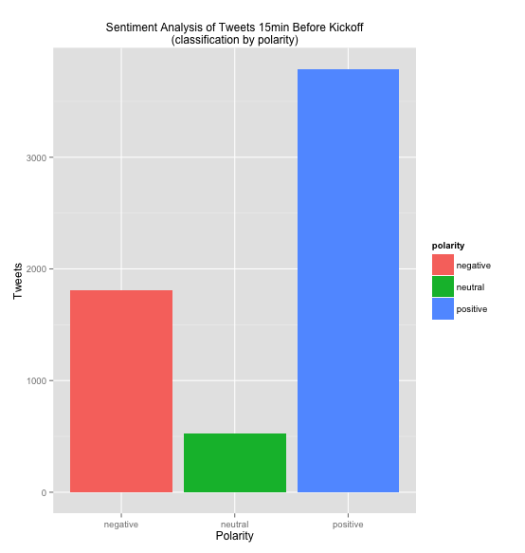
15min Before Kickoff
Large number of tweets created before the kickoff.
These tweets seem to be mostly positive.

Slide 8
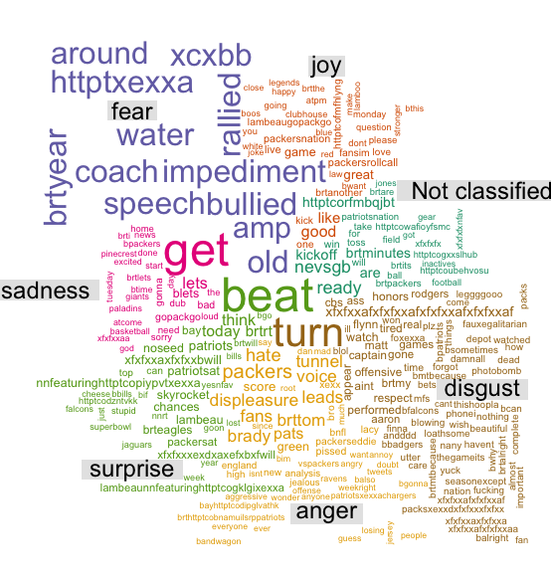

Slide 9
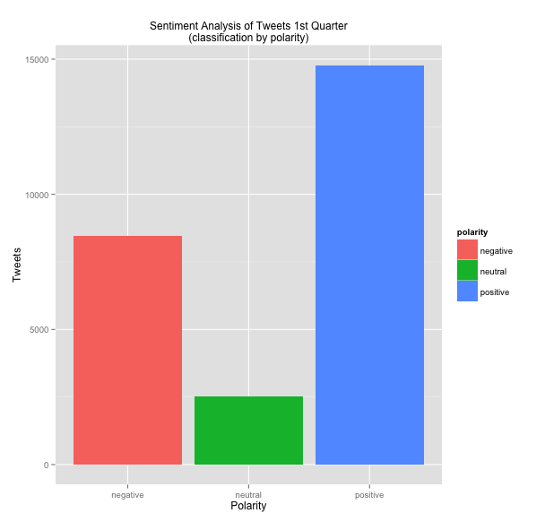
1st Quarter
A large increase in the number of tweets made during the first quarter.
Ratio of between positive to negative tweets looks to have stayed the same compared to tweets made 15min before the kickoff.
1st quarter ends with score
GB 13 – NE 0

Slide 10
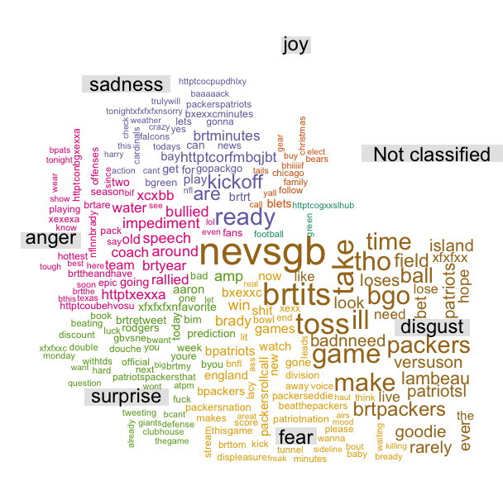

Slide 11
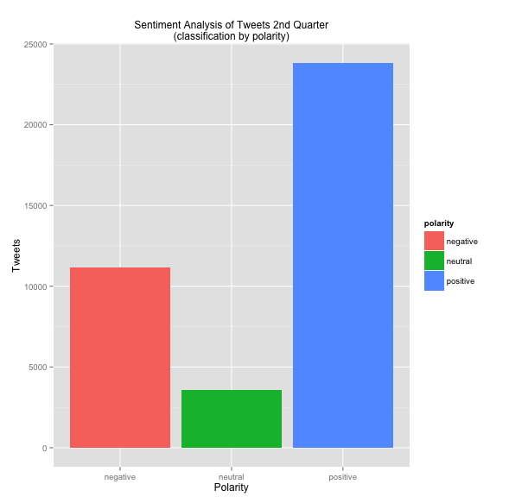
2nd Quarter
As the game progresses, more and more tweets enter per time period.
Most of the growth was observed in positive tweets throughout in the 2nd quarter. This may be due to the Patriots scoring 2 touchdowns, and reducing the spread, while Green Bay managed to conserve the lead.
The half ends with a score of GB 23- NE 14

Slide 12
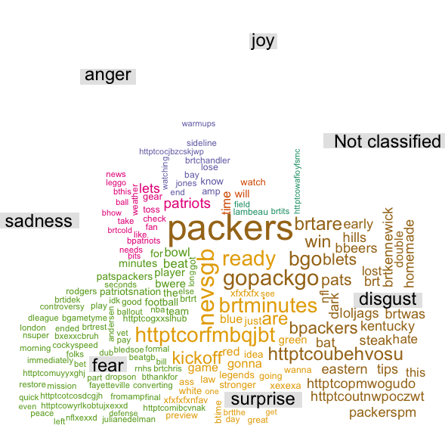

Slide 13
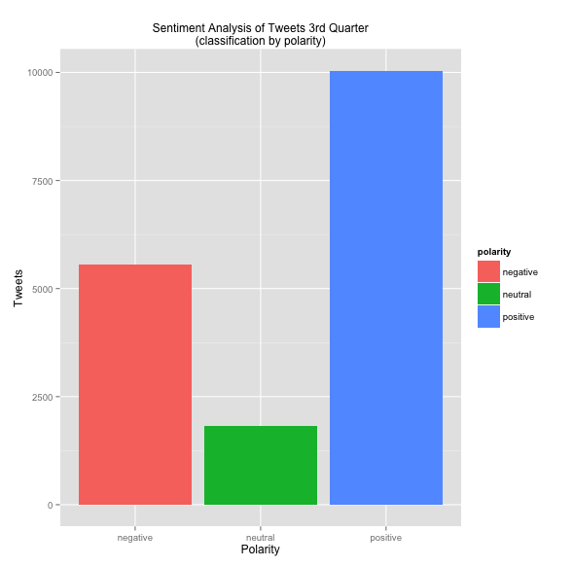
3rd Quarter
For the first time in the game, we observe a decrease in users tweeting about the game.
Also seems that users are posting negative tweets more frequently than as opposed to other periods. Possibly due to lack of scoring plays, as NE cannot tie the game, and Green Bay cannot extend their lead

Slide 14
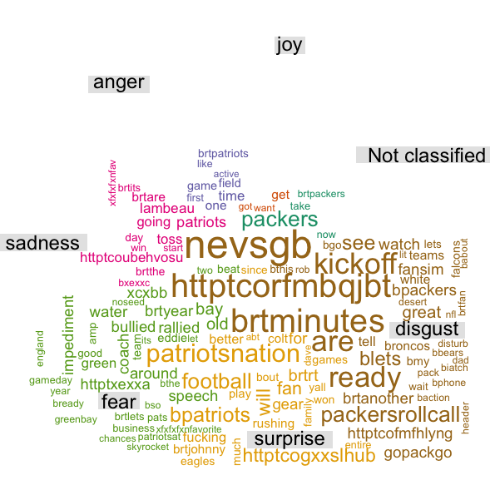

Slide 15
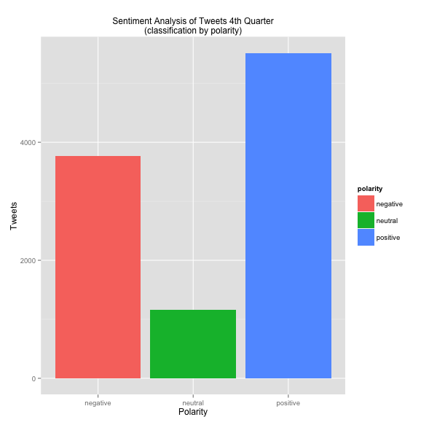
4th Quarter
2nd quarter in a row with a further decrease in Twitter commentary about the game
As the game closes, it seems those with more negative perceptions of the game are likely to tweet on that sentiment.
Can observe keywords in word cloud, such as “Choke”.
Game ends with score GN 26- NE 21

Slide 16
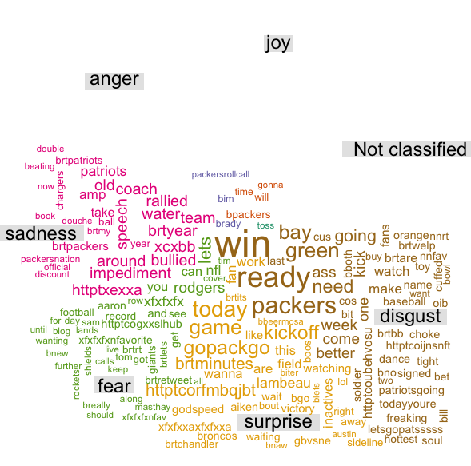

Slide 17
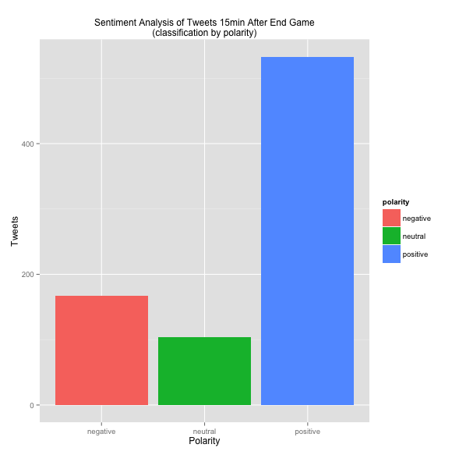
15min After End of Game
A final drop in the number of tweets written.
Those angry at the game must have destroyed their phone or computer, since there is a drop off in the number of negative tweets versus positive tweets.

Slide 18
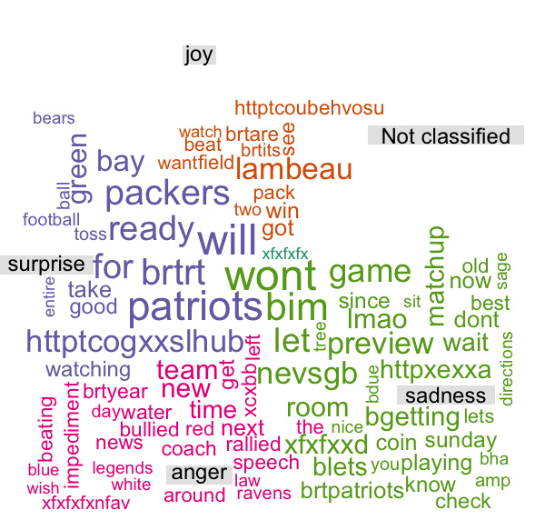

Slide 19
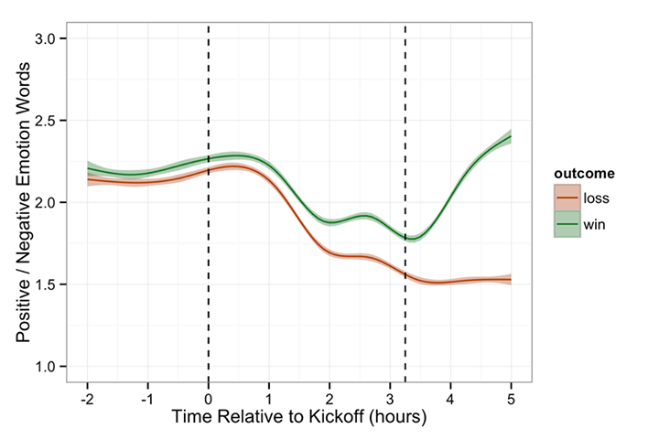
Conclusion
Users with positive sentiment seem to post more. Negative sentiment posters wanes as outcome looks more dire.
Consistent with Facebook’s analysis of status updates with regards to NFL games.(Taylor, 2014)

Slide 20
Where to go from here
We can further classify the tweets into two subgroups, based on what team tweets refer too
We can perform the same procedure as carried out in the above slides to analyze the overall sentiment for each team
Potential Thesis: The sentiment analysis can be indicator of ticket sales of the next sporting event.

Slide 21
Citations
Sinha, Shiladitya, Dyer, Chris, Gimpel, Kevin and Smith, Noah A.. "Predicting the NFL using Twitter.." CoRR abs/1310.6998 (2013): .
Taylor, Sean. "The Emotional Highs and Lows of the NFL Season." The Emotional Highs and Lows of the NFL Season. N.p., 30 Jan. 2014. Web. 7 Dec. 2014. <https://www.facebook.com/notes/facebook-data-science/the-emotional-highs-and-lows-of-the-nfl-season/10152033221418859>.

